Slide 1





Migration of SQL data to Azure
Azure Migration
Pre-migration -> Discover -> Assess -> Convert
During assessment, Team will desired the azure database or managed instance
During assessment, team will understand existing database design, version of SQL in use, expected to-be state and come up with detailed plan for migration to Azure
Hexaware can explore utilizing its Cloud EDMA framework jointly developed by Microsoft and Hexaware to enable any cloud based data warehouse capability
Migration -> Migrate schema, data, and objects -> Sync data -> Cutover
Use of Microsoft tools and best practices for Migration
Post-migration -> Remediate applications ->Perform Tests ->Optimize
After Post-migration, We will desired right instance size of azure database
Configure Azure feature like Geo replication, Encryption, Backup Policy
Limitation
Azure SQL Managed Instance support most of feature in on prime SQL server
Azure SQL DB is Fully PaaS Platform, it has many deprecated feature compare to on prime SQL server
Azure Data Migration Service support after SQL Server 2005 version
Azure Native Restore support after SQL Server 2012 SP 1 later version
If SQL Server Database is older version 2005 or older, then Migrate to SQL server 2012 or latest version
Pre-Migration – Azure Assessment Tool Report With Recommendations
Backup to Azure Storage
Use Azure Database Migration Service
Azure SQL DB/ Managed Instance
Azure SQL Managed Instance
Post-Migration – Functional & Performance Test with Report

Slide 2
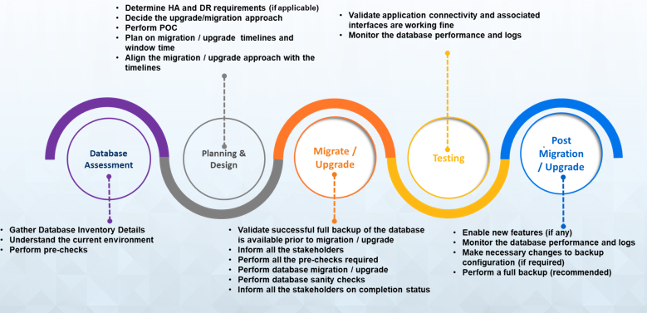
Hexaware SQL Migration Approach

